Slide 1
HOW TO INSTALL AND USE THE “ZOOM APPLICATION”?
Follow these simple steps to install and use the zoom application.

Slide 2
STEP -1 OPEN YOUR WEB BROWSER ON YOUR DESKTOP OR LAPTOP. YOU CAN USE YOUR MOBILE PHONES AS WELL. Go to google – www.google.co.in Some commonly used web browsers are-

Slide 3
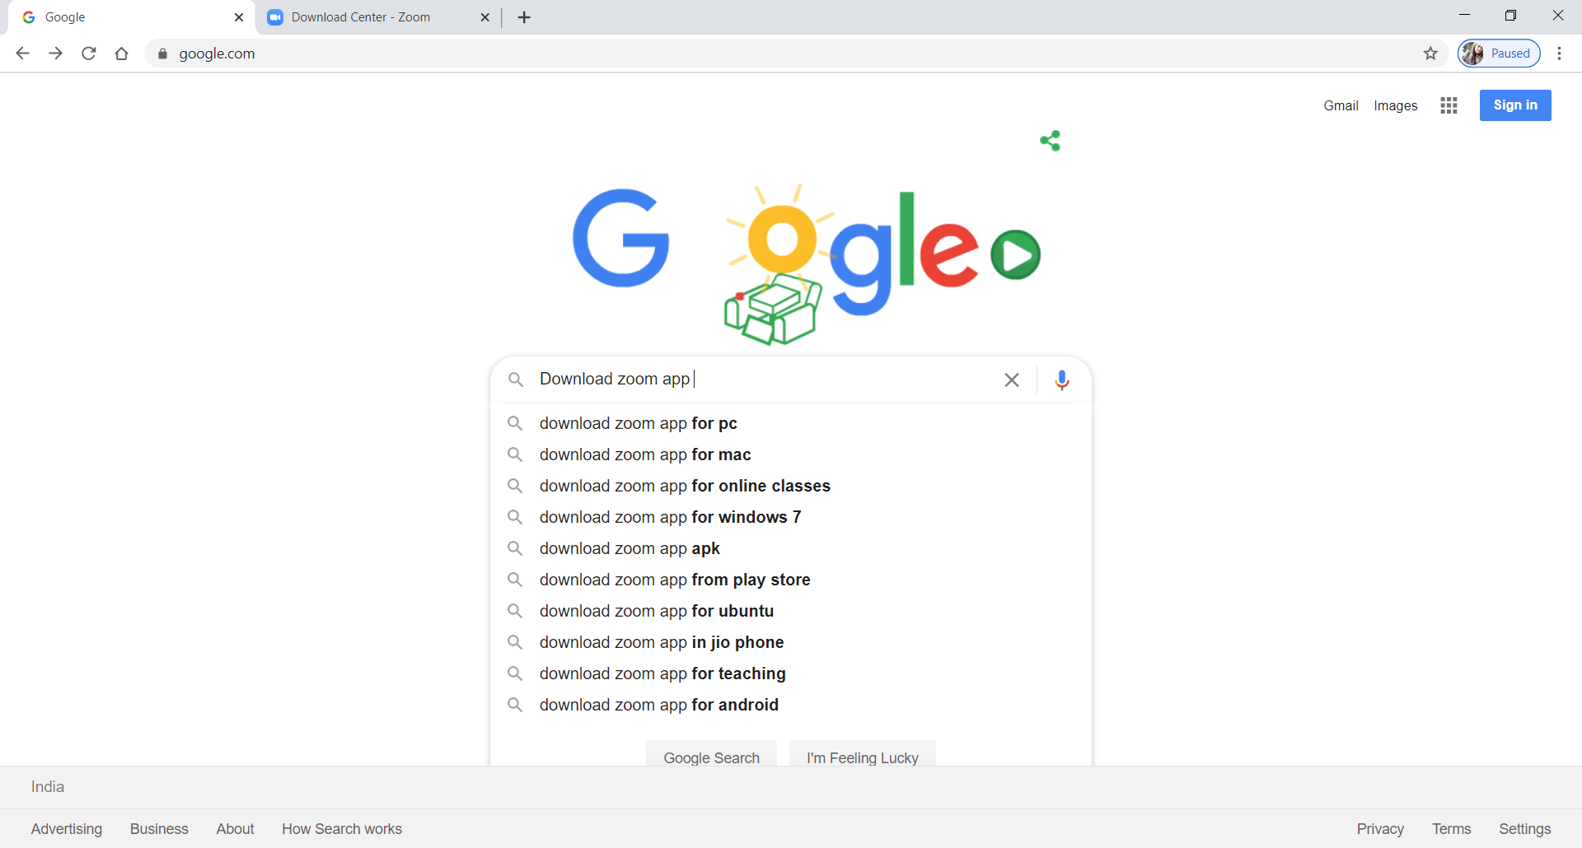
STEP -2 TYPE- “ DOWNLOAD ZOOM APP” IN THE SEARCH BAR

Slide 4
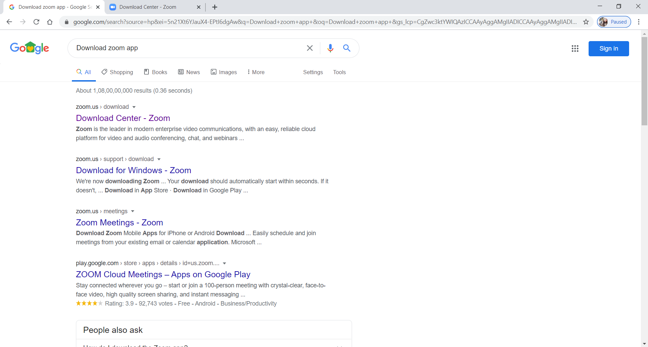
STEP -3 Choose the first link- zoom.us/download

Slide 5
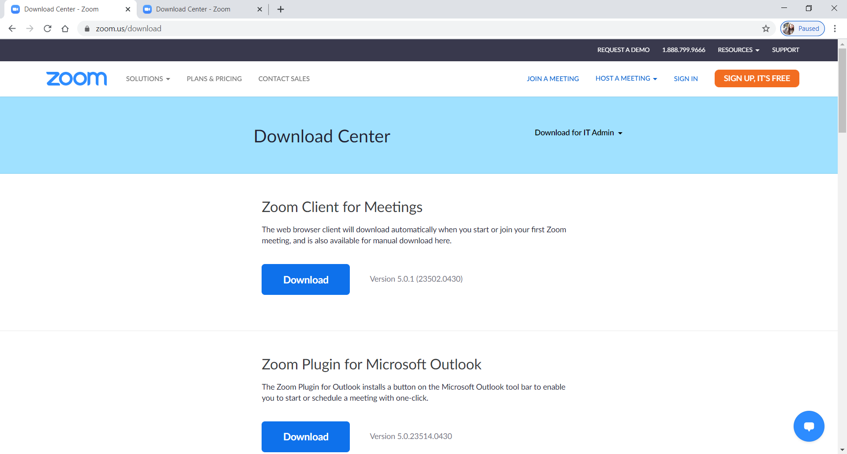
This window will open. STEP -4 Select Zoom Client for Meetings. Click on DOWNLOAD.

Slide 6
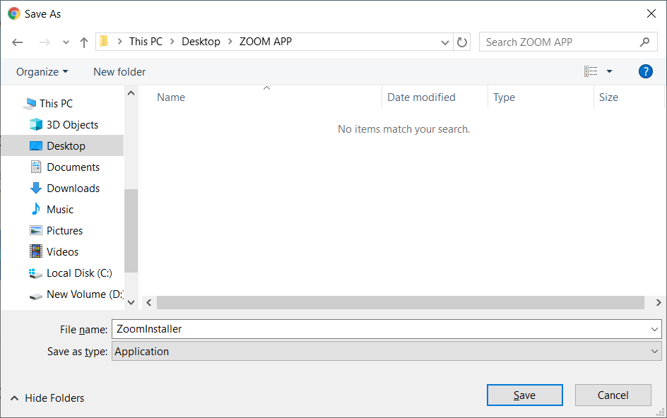
STEP -5 Choose the location where you want to save it and click on SAVE .

Slide 7
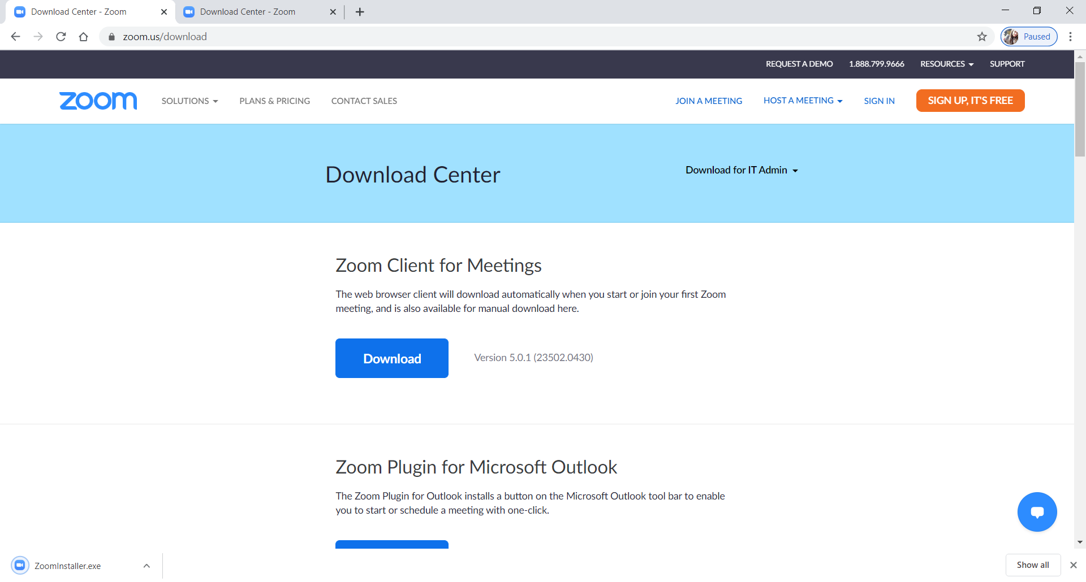
STEP -6 Your “ZOOM INSTALLER” will be downloaded. See the bottom of your screen.

Slide 8
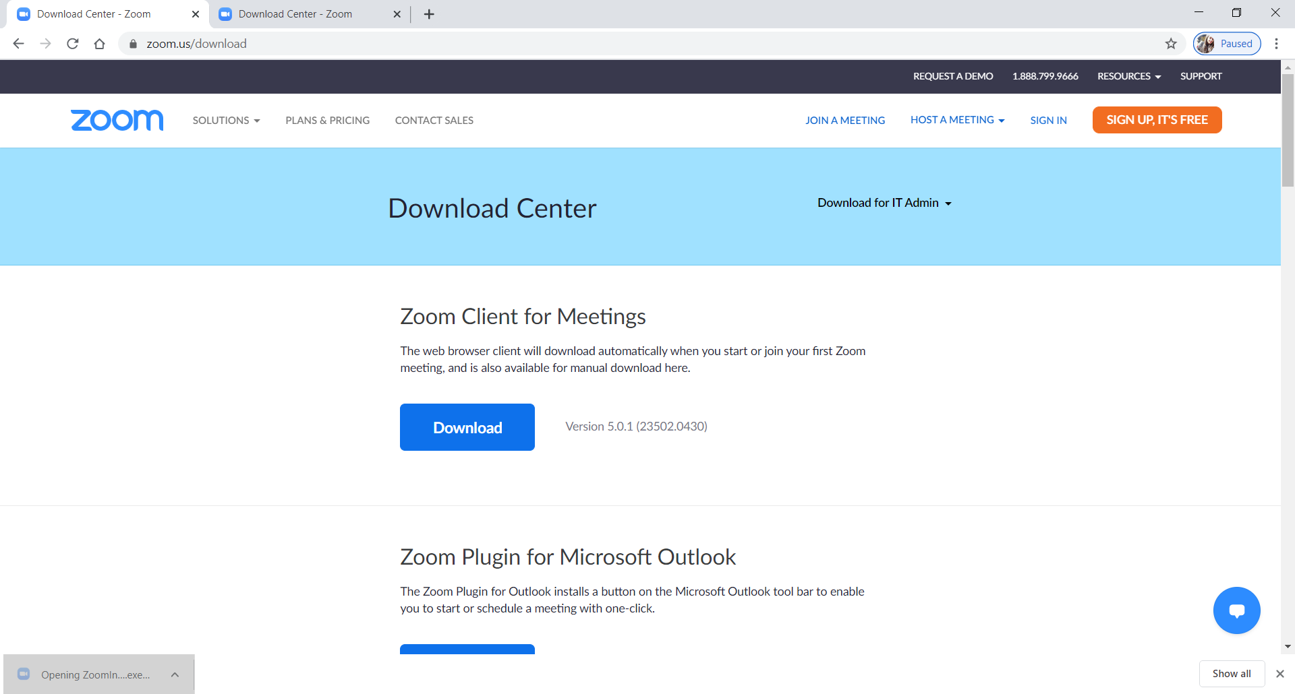
STEP -7 Click on the downloaded installer once the download is complete.

Slide 9
STEP -8 Wait for 100% installation.

Slide 10
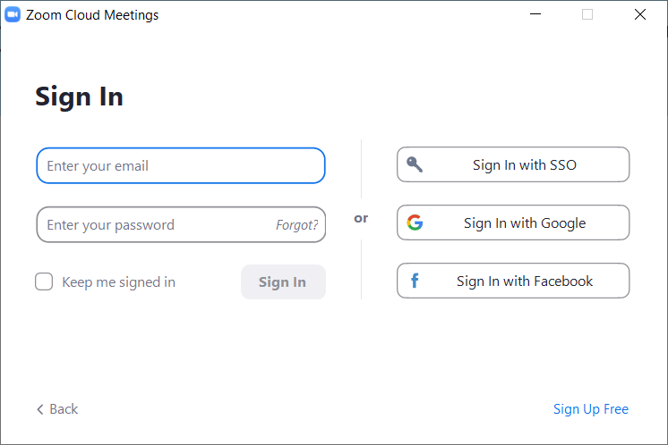
STEP-9 The following screen will appear. Type your login id and password (provided by the school).

Slide 11
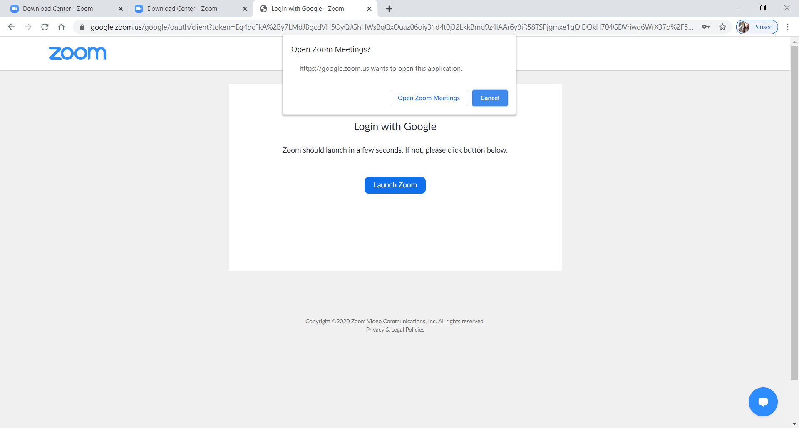
STEP -10 The following window appears. Click on “Open Zoom Meetings”.

Slide 12
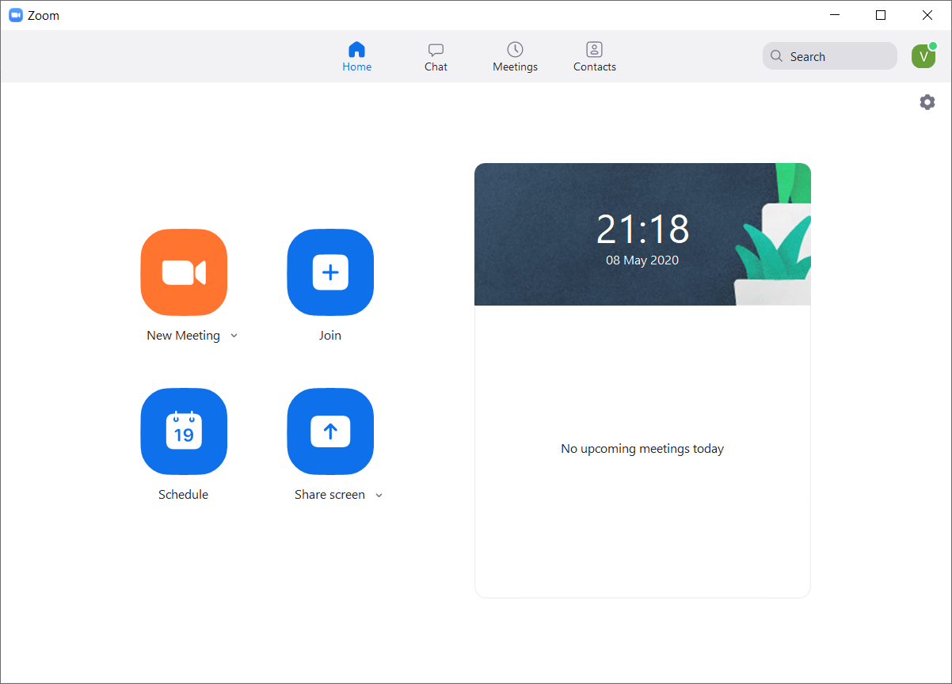
STEP -11 The following window appears. Click on “JOIN” icon.

Slide 13
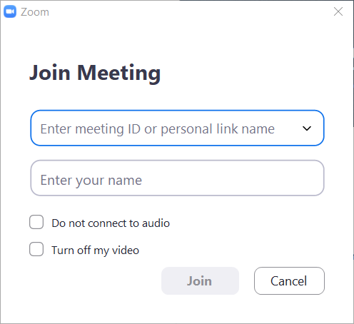
STEP -12 Enter meeting ID and password as required.

Slide 14
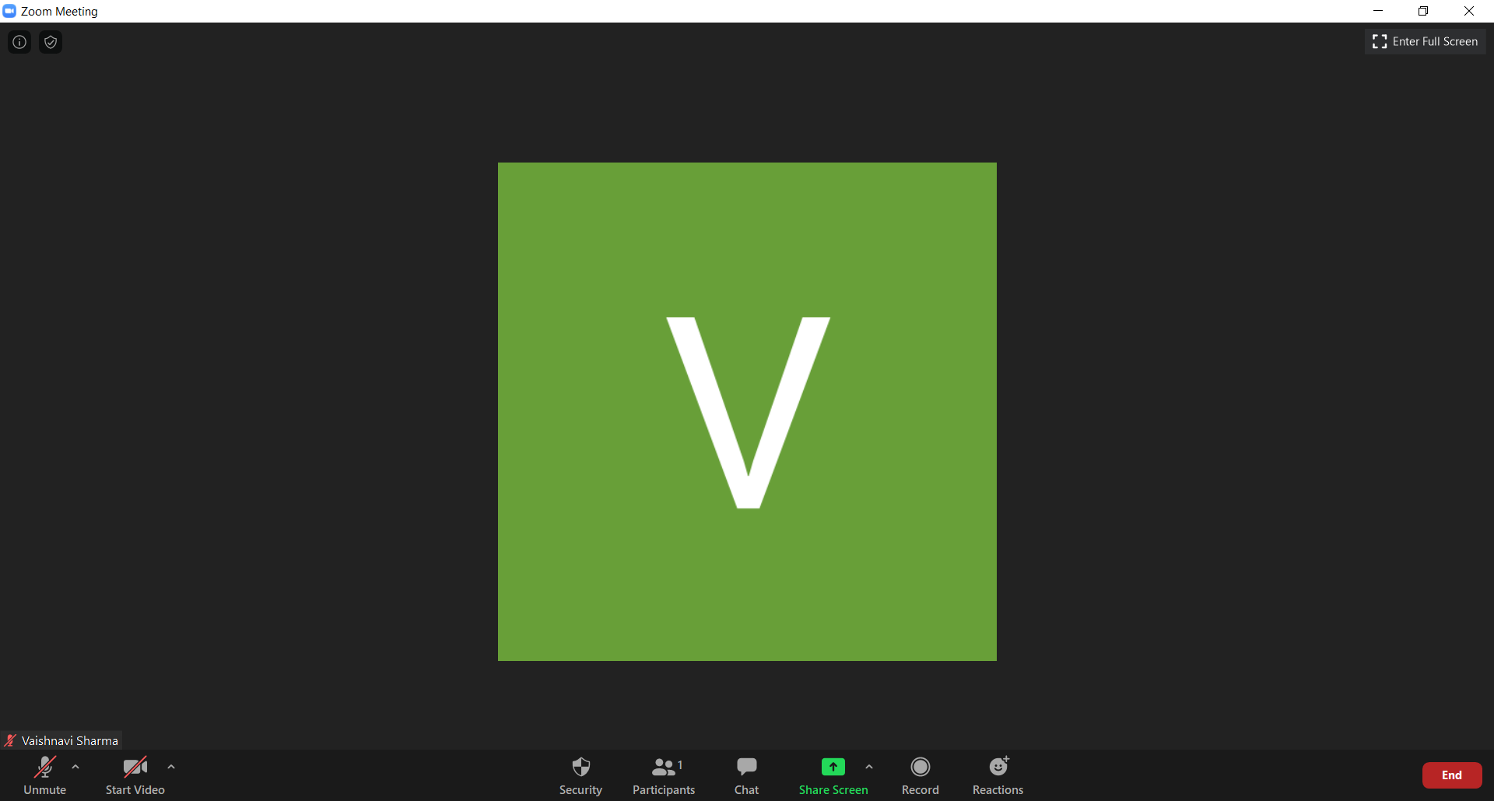
STEP -13 THIS IS YOUR ZOOM SESSION MAIN SCREEN.

Slide 15
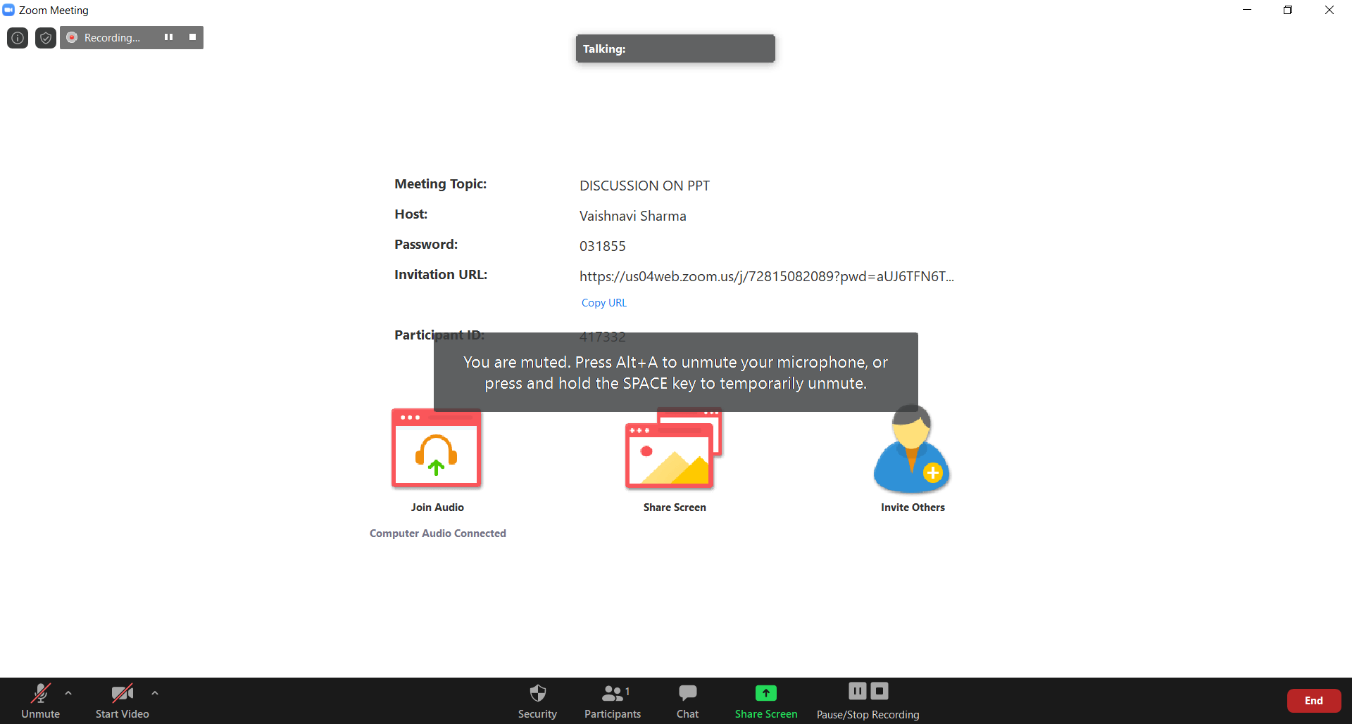
STEP -14 This is how your screen will look once you’ve joined the scheduled class.

Slide 16
STEP -13 THIS IS YOUR ZOOM SESSION MAIN SCREEN.
You can Mute and Unmute yourself using this feature.
You can start and stop sharing your video using this feature .
Use this feature to type in the CHAT BOX.

